Slide 1
Current success
Human still should give macro command.
Auto decision-making framework is important
Policy should have ability to identify danger and modify the macro command.

Slide 2
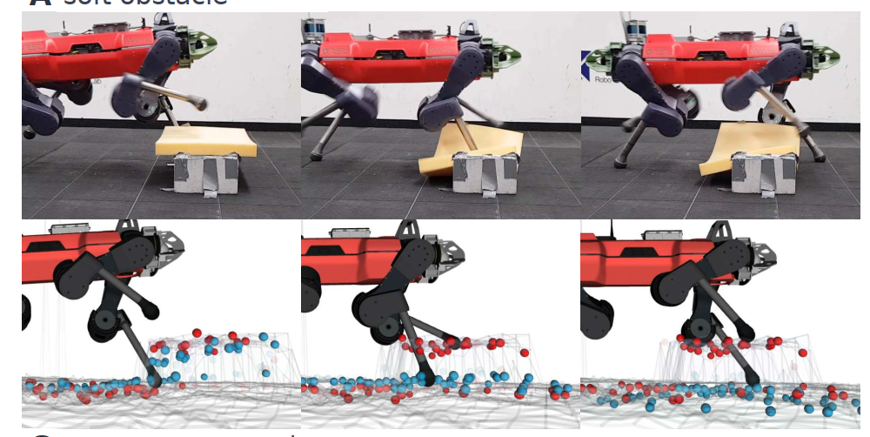
Adaption can be danger [1]: We can not correct the brief states by probing if the state in front of the ﻿quadrupedal robot are danger (﻿e.g., cliff/ fragile ground that cannot support the foothold).

Slide 3
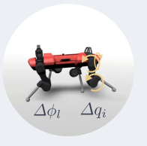
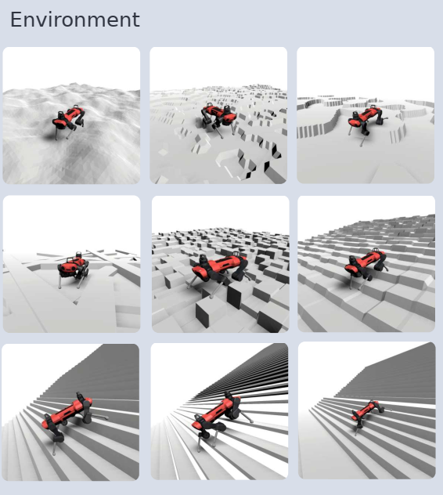
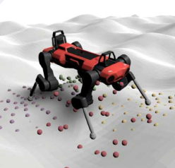
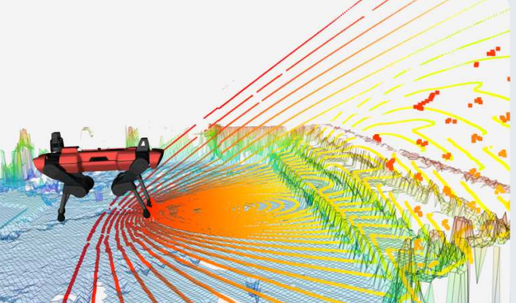
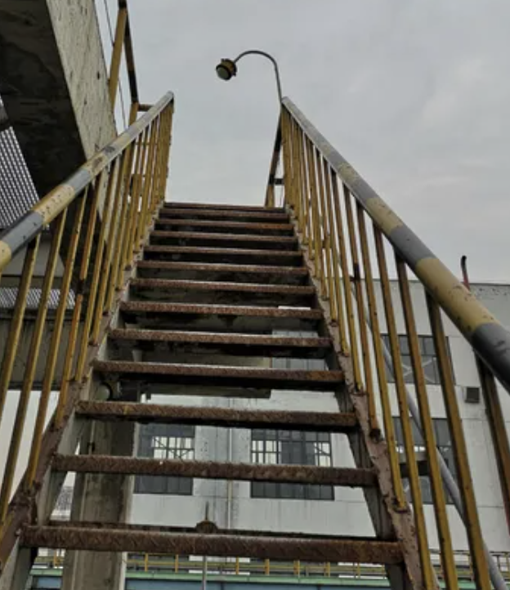
replan
Navigation planner
Add block
﻿Command ﻿﻿Proprioception
Local motion
﻿height scan
Gamma decay
Ensemble noisy future scan
Ensemble Future brief ﻿ encoder
Lidia
GRU
Hidden state
Brief decoder
RGB Camera
Model rollout
reconstruction
﻿Privileged info
Future ground
Future front

Slide 4
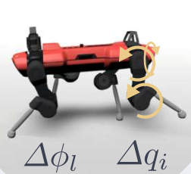
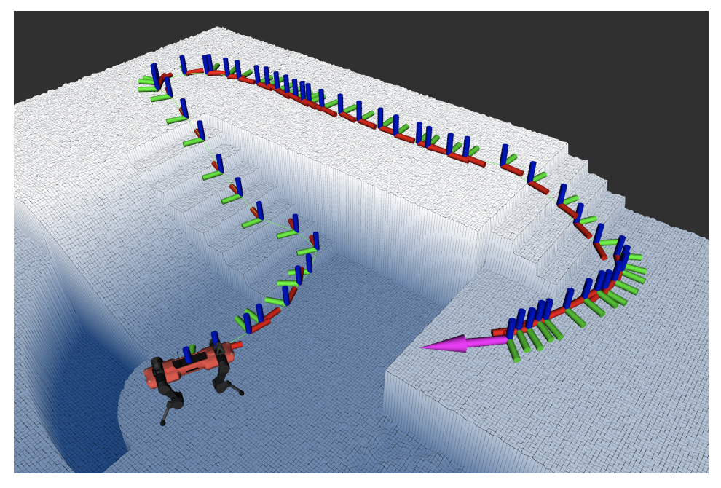
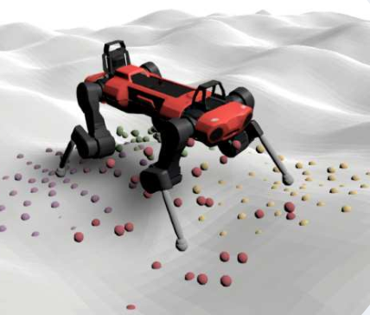
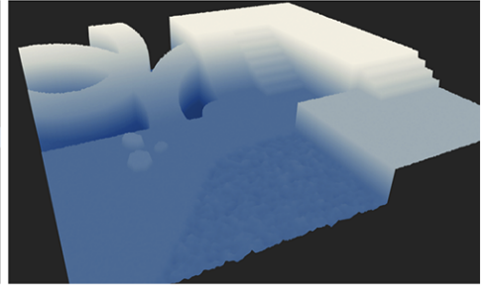
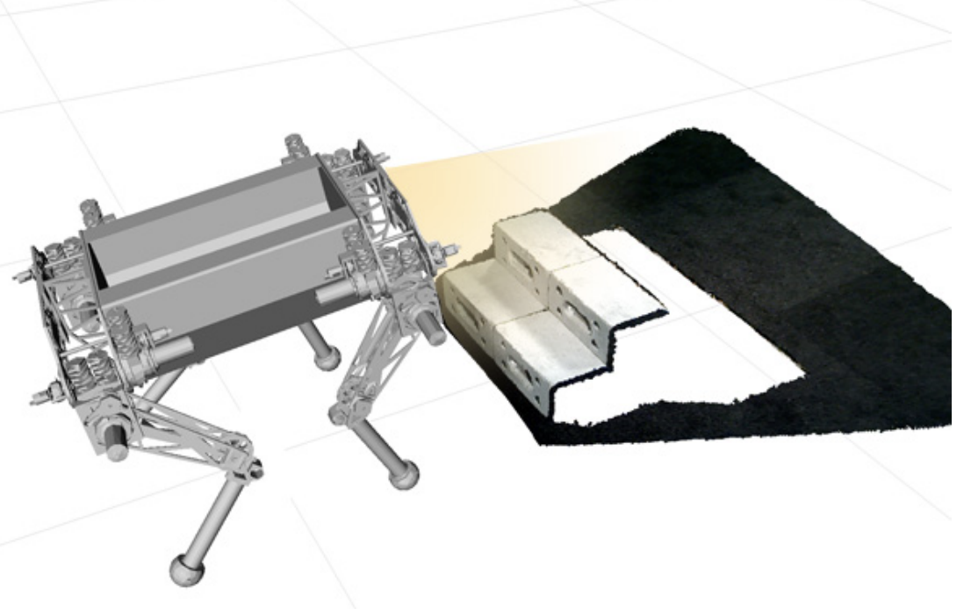
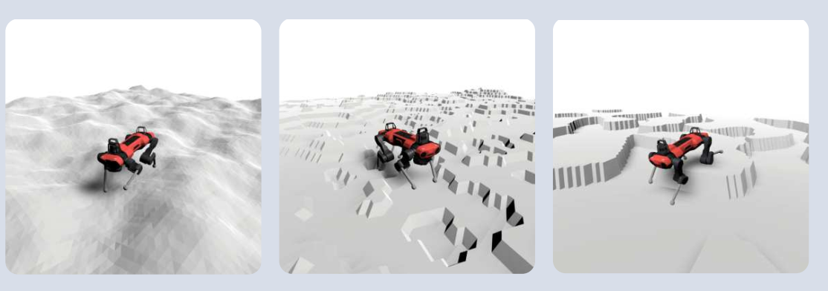
pretrained﻿ robust perceptive locomotion policy [1]
Global navigation
action
Some Navigation Planning algorithms
﻿Command ﻿﻿Proprioception sequential
MLP
Noisy height scan
Belief encoder
hidden
Static navigation Map
Ensemble noisy future scan
Lidia
Color Camera
… …
Model rollout
Environment
Domain randomization with different terrains and danger obstacles
Danger obstacles

Slide 5
(4) robust perceptive locomotion policy [1]
(2) Global navigation
action
Some Navigation Planning algorithms
﻿Command ﻿﻿Proprioception sequence
Encoder
Belief
encoder
MLP
Noisy height scan
(3) Safe probing policy
Static navigation Map
Ensemble noisy future scan
obstacles identified by
probing module
noisy Lidia infos
noisy Color Camera
… …
model rollout states
Add a obstacle to the map and replan to generate a new command ﻿﻿proprioception sequence if the confidence is near to zero (means the future state is danger or indistinguishable).
Probe confidence
(1) Environment
Domain randomization with different terrains and danger obstacles
are danger obstacles

Slide 6
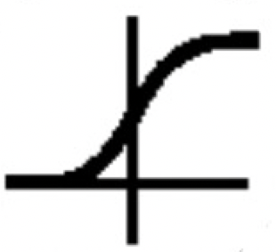
(2) Global navigation
(4) robust perceptive locomotion policy [1]
Navigation Planning algorithms [2]
﻿Command ﻿﻿Proprioception sequence
Pretrained student policy
Noisy height scan
(3) Safe probing policy
action
Ensemble ﻿exteroceptive future encoder [3]
Static navigation Map
Ensemble noisy future scan
obstacles identified by
probing module
noisy Lidia info
noisy color camera
Belief encoder
… …
model rollout states
hidden
MLP
Add an obstacle “ ” to the map and replan to generate a new command ﻿﻿proprioception sequence
near zero?
yes
decay the command
for safe probing
(1) Simulator
decoder
Sigmoid prob confidence
Domain randomization with different terrains and danger obstacles
Train for reconstruction
﻿Privileged future states
Train with RL
Rewards
are randomized danger obstacles

Slide 7
(2) Global navigation
(4) robust perceptive locomotion policy
Navigation Planning algorithms [2]
﻿Command ﻿﻿Proprioception sequence
Pretrained robust controller
Noisy height scan
(3) Safe probing policy
action
Ensemble ﻿exteroceptive future encoder [3]
Static navigation Map
Ensemble noisy future scan
obstacles identified by
probing module
noisy Lidia info
noisy color camera
Belief encoder
… …
model rollout states
hidden
MLP
Add an obstacle “ ” to the map and replan to generate a new command ﻿﻿proprioception sequence
near zero?
yes
(1) Simulator
confidence
rectification
decoder
Domain randomization with different terrains and danger obstacles
Train for reconstruction
﻿Privileged future states
Train with RL
Rewards
are randomized danger obstacles

Slide 9
pontential challenges
Design of future state
Ensemble encoder
Ensemble scan design
Prob policy training
navigation

